Slide 1
Stroke Prediction
Team 10 TechEagle
Nigel Wang, Susie Li, Faustin Nzitonda, Jennifer Kim

Slide 2
01
Business Understanding
What we are doing in this business problem
The business meaning we are doing here
02
Data Understanding
Data and data sources description
Insights we get from data
03
Data Preparation
How we integrate these data to produce the format required for data mining
Modeling
04
Specify the type of model built.
Discuss choices for data mining algorithm: what are alternatives, and what are the pros and cons.
Why and how this model should “solve” the business problem
05
Evaluation
Model Evaluation (F1, Recall, Precision, Accuracy)
Profit Curve (benefit-cost)
06
Deployment
Discuss how the result of the data mining will be deployed.
Discuss any issues the firm should be aware of regarding deployment.
Identify the risks associated with your proposed plan and how we would mitigate them

Slide 3

1
Business Understanding

Slide 4
Business
Problem
A stroke is caused when blood flow to a part of the brain is stopped abruptly. Without the blood supply, the brain cells gradually die, and disability occurs depending on the area of the brain affected.
According to the World Stroke Organization, 13 million people get a stroke each year, and approximately 5.5 million people will die as a result.
We want to predict whether a person is likely to get a stroke or not
In business scenario, many stakeholders would benefit from this predictive task. For instance,
smartwatch companies could also build such predictive models to better serve their customers;
insurance companies could use such predictive models to improve the health outcomes of their patients and optimize revenue;
healthcare providers could also benefit from these predictive models to increase patient satisfaction, etc.
Resources: Dritsas, E., & Trigka, M. (2022). Stroke risk prediction with machine learning techniques. Sensors, 22(13), 4670.

Slide 5
2
Data
Understanding

Slide 6
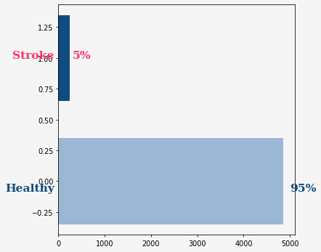
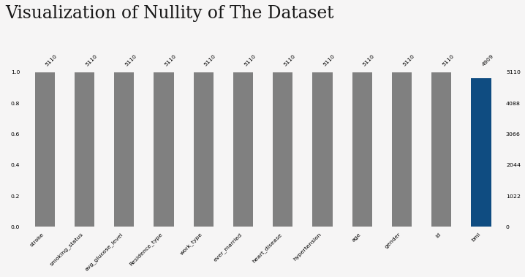
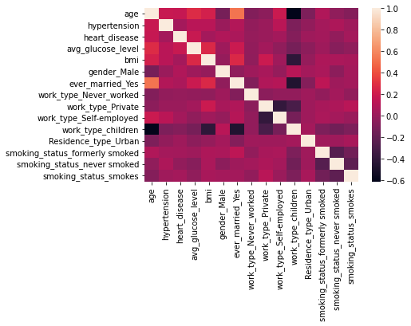
Dataset Exploration
Stroke dataset (from Kaggle)
X: different variables that pertain to patients' medical and personal historical data such as gender, age, hypertension, heart disease, marital status, work type, residence, average glucose level, body mass index, and smoking status
y: whether she/he was diagnosed with stroke
https://www.kaggle.com/datasets/fedesoriano/stroke-prediction-dataset
Imbalance Data
Variable BMI Has Missing Value
No Obvious Multicollinearity

Slide 7
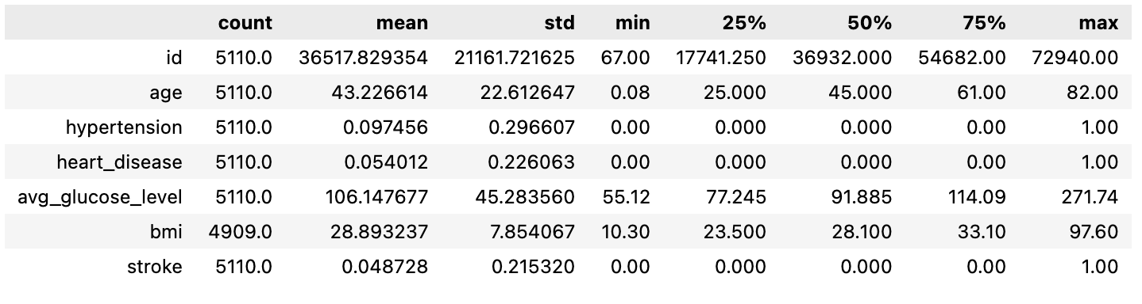
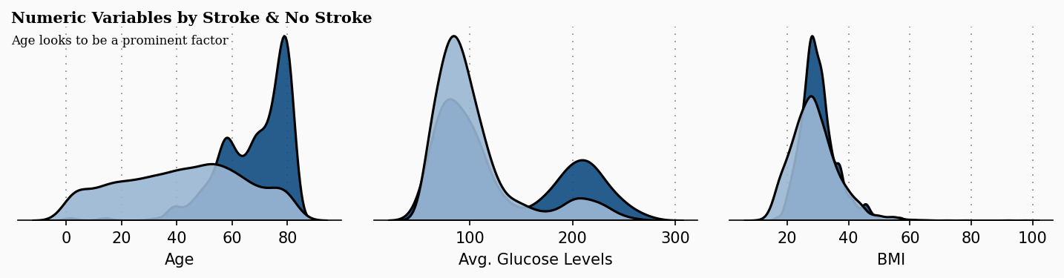
Numerical Variables Exploration
Age looks to be a prominent factor - we assume this will likely be a salient feature in our models

Slide 8
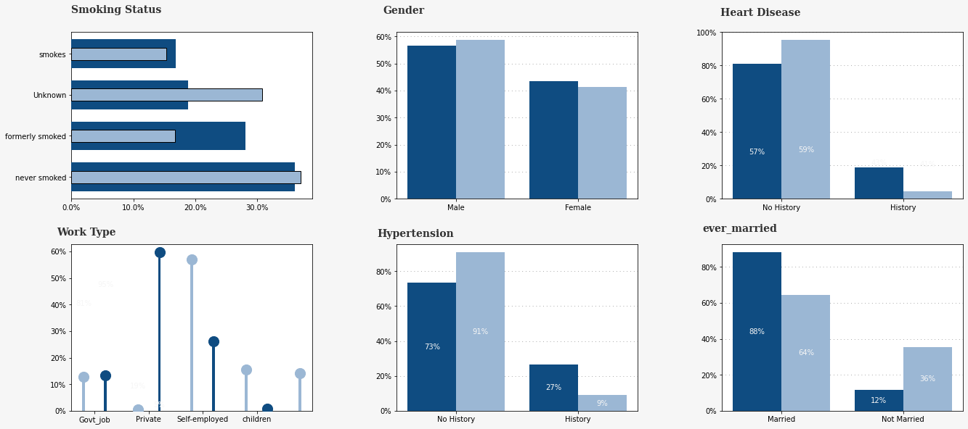
Categorical Variables Exploration

Slide 9
3
Data
Preparation

Slide 10
Data Preparation
Features & Dataset Exhibition
Numerical Variables
'age'
'avg_glucose_level'
'bmi'
Categorical Variables
'hypertension'
'heart_disease'
‘gender_Male'
'ever_married_Yes'
'Residence_type_Urban'
working type dummies
'work_type_Never_worked'
‘work_type_Private'
'work_type_Self-employed'
'work_type_children'
Smoking status dummies
'smoking_status_formerly smoked'
'smoking_status_never smoked'
'smoking_status_smokes'
X: (8262, 15)
y: (8262, 1)
Data Processing Steps
Missing value(s)
Only feature BMI has 201 missing values, used KNN imputation to replace all missing values
Target Variable Encoding
Not Stroke: 0
Stroke: 1
Dummy Variables
Created n-1 dummies for each categorical variable
15 features after creating dummies
Oversample the Imbalanced Target Variables
Original Target Variables Classes Ratio: 0: 4860, 1: 249
Applied Smote Function to oversample minority class, the rationale behind this algorithm is KNN as well
Target Variables Classes Ratio After Oversample: 0: 4860, 1: 3402, which is 1:0.7

Slide 11
4
Modeling

Slide 12
Modeling
Performance Metric: f1 score
Replicable Model Building Process: np.random.seed= 42
Parameter Tuning Method: Nested Cross Validation (5 folds for parameters tuning, 5 folds for generalized performance score)
Decision Tree
Tuned Hyperparameters
max_depth: from 1 to 20, and no limit
criterion: gini, entropy
Performance
Non-nested CV f1: 0.89
Optimal Parameter:
criterion: entropy, max_depth: 19
Nested CV F1: 0.88 +/- 0.006
KNN Classifier
Tuned Hyperparameters:
Number of Neighbors: 1 to 21
Methods of Weights Calculation: 'uniform', 'distance'
Distance Computation Metrics: l1, l2
Performance
Non-nested CV F1: 0.90
Optimal Parameter:
metric: l1, n_neighbors: 1, knn__weights: uniform
Nested CV F1: 0.90 +/- 0.006
Logistics Regression
Tuned Hyperparameters:
Inverse of regularization strength: 10^n for n from -5 to 7
penalty: l1, l2
Performance
Non-nested CV F1: 0.83
Optimal Parameter: C: 1, penalty: l2
Nested CV F1: 0.83 +/- 0.007

Slide 13
Models Comparison
 | Decision Tree | KNN | Logistic Regression
Pros | Easy to understand • Easy to implement • Easy to use • Computationally cheap | • Easy to implement and use • Robust (handles noisy data well, except for very low k values) • No statistical / distributional assumptions required • Captures complex interactions between variables without building models | • For smaller training-set sizes, logistic regression yields better generalization accuracy • Give information for relevant of the attributes
Cons | • Require pruning to avoid overfitting data • Greedy (may not find the best tree) • Boundaries can only be perpendicular to the instance-space axes | • Takes more time to perform estimation • Requires a lot of storage • Lack of interpretable model • Curse of dimensionality and domain knowledge | Has assumptions for linear regression

Slide 14
5
Evaluation

Slide 15
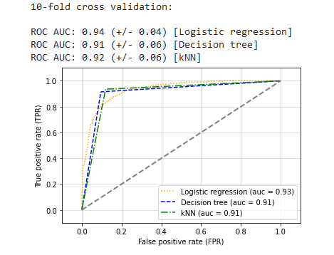
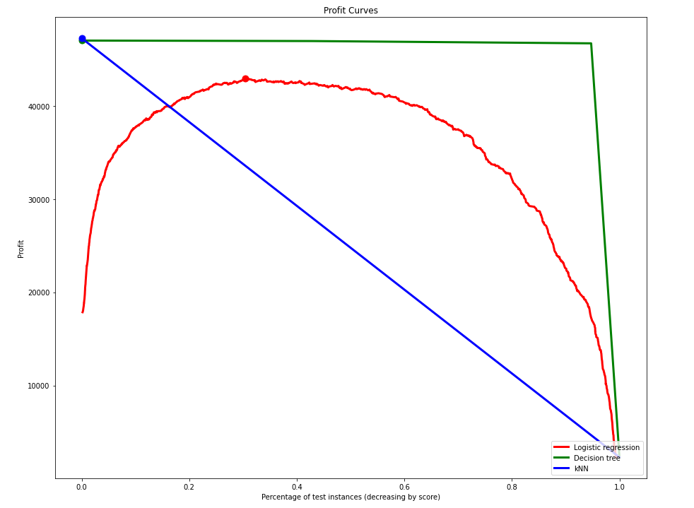
Evaluation
Logistic Regression, Decision Tree and KNN were Optimized using F1 score
Model | F1 | Recall | Precision | Accuracy
LR | .82 | .83 | .82 | .86
DT | .89 | .91 | .86 | .91
KNN | .88 | .93 | .83 | .90
Some assumptions we made(cost benefit matrix)(ROI)
 | Stroke | Not Stoke
Predicted Stroke | $49128 | -$2254
Predicted Not stroke | -$86164 | $59039
Model | E[Profit]
LR | $41787.22
DT | $46977.91
KNN | $47278.61
Reference [1] https://www.ncbi.nlm.nih.gov/pmc/articles/PMC4544732/ [2] https://www.jns-journal.com/article/S0022-510X(19)32408-6/fulltext [3] https://www.census.gov/content/dam/Census/library/publications/2017/acs/acsbr16-02.pdf

Slide 16
6
Deployment

Slide 17
Deployment
The model can be used to predict whether an individual is likely to be diagnosed with stroke in order to reduce the cost.
Research (CMPA) suggests 10% of cases are initially not diagnosed due to no symptoms. Predictive models can help to decide whether to proceed further diagnosis for a possible patient.
Healthcare
providers
benefit
What firms should consider at this stage:
Costs/Benefits of modeling:
Logistic regression may not be the best representation for larger datasets.
Ethical / Risk Considerations:
Transparency of the data/ voluntary participation may lead to nonrandom sampling
Remove confidential data before disclosure/usage
Reduce risk of sampling bias through oversampling
May be prone to error in ML process
Stakeholder
benefits
Insurance companies can utilize model to predict insurance/mortality rates.
Serve as a model to build applications that embed health indicator purposes

Slide 18
THANK YOU

